Slide 1




Autonomous Flood Inundation Mapping Agent
Real-Time Emergency Response System
The Challenge
Limited Real-Time Data
Missing Flood Maps
Evacuation Delays
Flood response delayed due to reliance on late satellite imagery and manual reporting
Lack of accurate, real-time inundation maps during critical emergency response windows
Emergency teams need predictive flood extent and depth to coordinate evacuations
Our Solution
An autonomous agent that generates real-time flood maps by simulating water flow across elevation grids, processing sensor data, and predicting inundation patterns before they occur.

Slide 2

System Architecture & Methodology
Grid-Based Simulation
Three-Layer Architecture
20×30 elevation grid processes real-time inputs:
01
Rainfall intensity (60% weight)
River water levels (40% weight)
Digital Elevation Model (DEM)
Data Collection
Sensors feed rainfall and river data
Water flows from high to low elevation with weighted influence from sensor inputs.
02
Processing Engine
Simulation calculates flood extent
03
Visualization
Dashboard displays real-time maps
Sensor Inputs
Data Processing
Grid Simulation
Alerts & Dashboard

Slide 3
Implementation & Key Features
Phase 3: Full Integration
Phase 2: Debugging & Optimization
Connected frontend dashboard, backend engine, and API layer for real-time updates
Phase 1: AI-Based Code Generation
Fine-tuned flood logic, fixed edge cases, and optimized grid update algorithms
Developed core simulation algorithms using AI-assisted programming for rapid prototyping
System Features
Live Flood Map
Sensor Network
Color-coded depth visualization showing real-time inundation extent
Integrated rainfall and river level monitoring with dynamic updates
Alert System
Real-Time Updates
Low to critical warnings based on predicted flood depth and timing
Incremental cell updates every few seconds for stable, fast performance

Slide 4
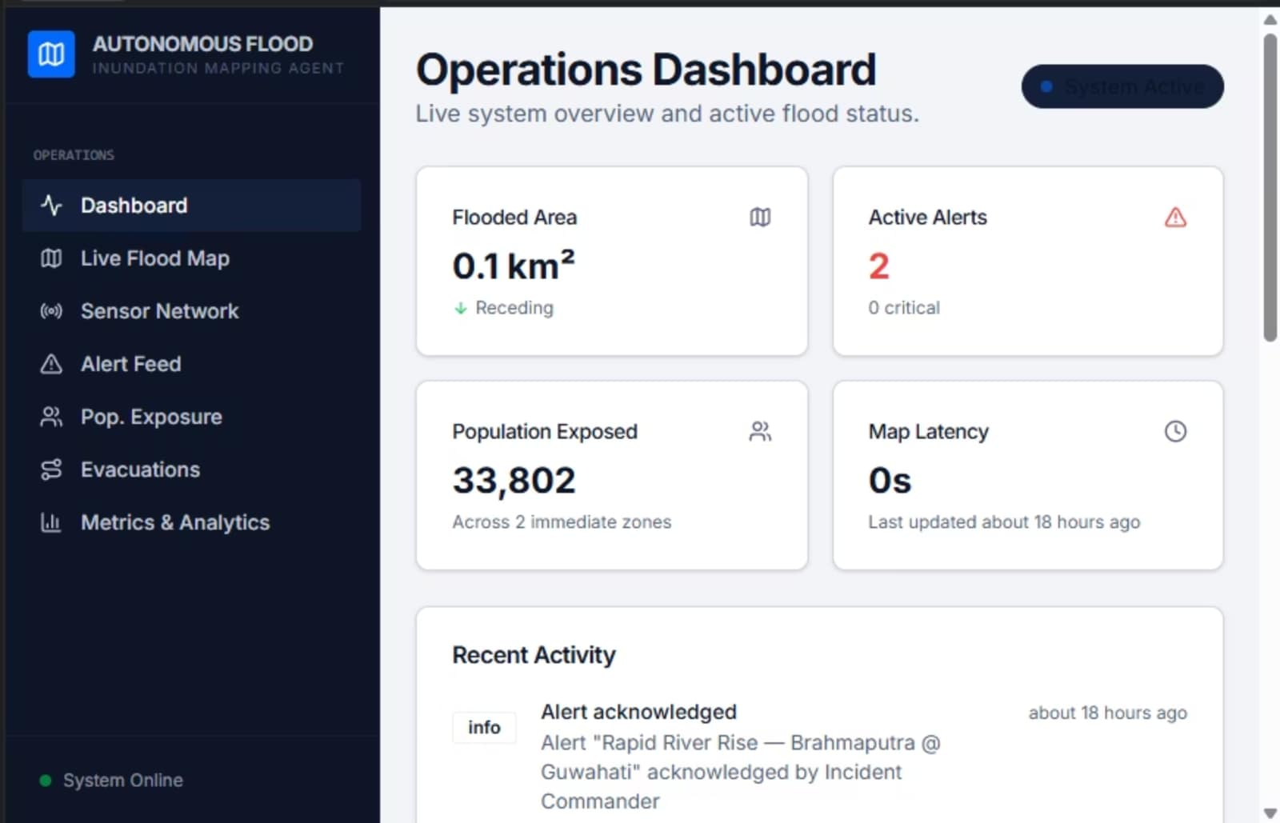



Results & Conclusion
Real-Time Visualization
Accurate Depth Prediction
Automated Alert Generation
Dynamic flood propagation displayed as it unfolds
Reliable water depth calculations support evacuation planning
Warning levels update based on simulated flood conditions
Conclusion
Successfully built a fully functional, real-time decision-support system that autonomously generates flood inundation maps and supports emergency response operations.

